Slide 1
Experience Hands-On Deep Learning with Microsoft Cognitive Toolkit 2.0 Anusua Trivedi Data Scientist ADS, AI + R

Slide 2
Tutorial Agenda

Slide 3
Agenda
Installation options
Tutorials
Multi-layer Perceptron
Text Classification
Reinforcement learning with Keras
Image Classification, Object Detection and Image Similarity
Distributed/Batch Training
Q & A

Slide 4
Traditional ML Vs DL
Traditional ML requires manual feature extraction/engineering
Feature extraction for unstructured data is very difficult
Deep learning can automatically learn features in data​
Deep learning is largely a "black box" technique, updating learned weights at each layer

Slide 5
Why is DL popular?
DL models has been here for a long time
Fukushima (1980) – Neo-Cognitron
LeCun (1989) – Convolutional Neural Network
DL popularity grew recently
With growth of Big Data
With the advent of powerful GPUs

Slide 6

Deep Neural Network (DNN)

Slide 7

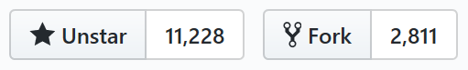
Microsoft Cognitive Toolkit (formerly CNTK)
Microsoft’s open-source deep-learning toolkit
https://github.com/Microsoft/CNTK
Created by Microsoft Speech researchers (Dong Yu et al.) in 2012, “Computational Network Toolkit”
On GitHub since Jan 2016 under MIT license
Renamed “Cognitive Toolkit”
Community contributions e.g. from MIT, Stanford and NVidia

Slide 8
The Microsoft Cognitive Toolkit (CNTK)
CNTK expresses (nearly) arbitrary neural networks by composing simple building blocks into complex computational networks, supporting relevant network types and applications.
CNTK is production-ready: State-of-the-art accuracy, efficient, and scales to multi-GPU/multi-server.
Notes:
The toolkit is tested in production setting for accuracy, efficiency and scalability in a multi-GPU/multi-server environment.
The toolkit is designed to bring lego like extensibility allowing for expression of arbitrary NN ……. Several use cases have been built using the toolkit for speech, image, text and combinations of the data types.

Slide 9

Microsoft Cognitive Toolkit
ease of use
what, not how
powerful stock library
fast
optimized for NVidia GPUs & libraries
best-in-class multi-GPU/multi-server algorithms
flexible
powerful & composable Python and C++ API
Linux and Windows
Development is completely in the open
Notes:
In conclusion, cognitive toolkit provides easy to use library of very performant deep learning application supporting very large production scale data. With its recent release of the Python APIs, Congitive toolkit offers a very flexible framework. We build and test for both linux and windows platforms. We embrace a completely open development environment in the true spirit of Democratising AI.

Slide 10
Anatomy of a training job
Python script configures and executes…
reader
• minibatch source • task-specific deserializer
• automatic randomization
• distributed reading
network
• model function • criterion function • CPU/GPU execution engine
• packing, padding
trainer
• SGD (momentum, Adam, …)
• minibatching
corpus
model

Slide 11
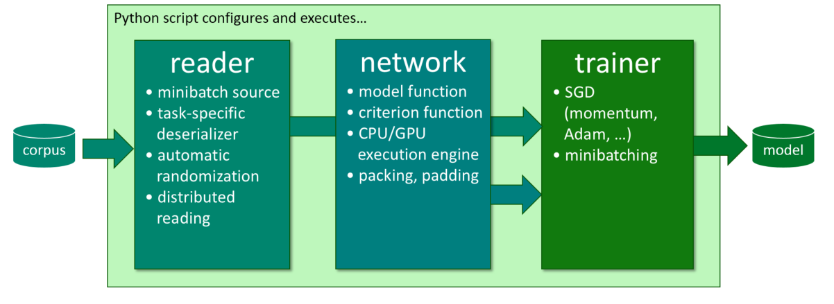
how to: reader
def create_reader(map_file, mean_file, is_training):
# image preprocessing pipeline
transforms = [
ImageDeserializer.crop(crop_type='Random', ratio=0.8, jitter_type='uniRatio')
ImageDeserializer.scale(width=image_width, height=image_height, channels=num_channels, interpolations='linear'),
ImageDeserializer.mean(mean_file)
]
# deserializer
return MinibatchSource(ImageDeserializer(map_file, StreamDefs(
features = StreamDef(field='image', transforms=transforms), '
labels = StreamDef(field='label', shape=num_classes)
)), randomize=is_training, epoch_size = INFINITELY_REPEAT if is_training else FULL_DATA_SWEEP)
automatic on-the-fly randomization important for large data sets
readers compose, e.g. image → text caption
Notes:
(just explain: (1) deserialization incl. IDeserializer and (2) auto-randomization)

Slide 12
how to: network
ce
cross_entropy
M = 40 ; N = 512 ; J = 9000 # feat/hid/out dim
x = Input(M) ; y = Input(J) # feat/labels
from layers import *
model = Sequential ([
Dense(N), sigmoid,
Dense(N), sigmoid,
Dense(J), softmax
])
P = model(x)
ce = cross_entropy(P, y)
P
softmax
b_{out}
+
W_{out}
•
h₂
σ
b₂
+
W₂
•
h₁
σ
b₁
+
W₁
•
x
y

Slide 13
how to: network
ce
cross_entropy
M = 40 ; N = 512 ; J = 9000 ; L = 2
x = Input(M) ; y = Input(J) # feat/labels
from layers import *
model = Sequential ([
[ Dense(N, activation=sigmoid)
for i in range(L) ],
Dense(J, activation=softmax)
])
P = model(x)
ce = cross_entropy(P, y)
P
softmax
b_{out}
+
W_{out}
•
h₂
σ
b₂
+
W₂
•
h₁
σ
b₁
+
W₁
•
x
y

Slide 14
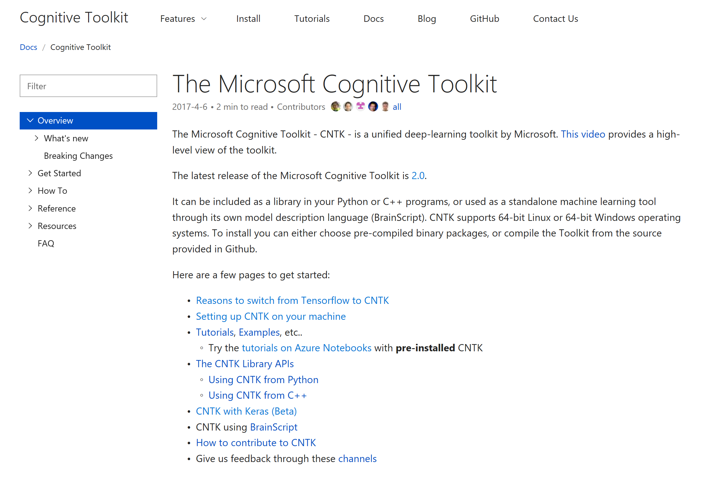
Where to begin?
GitHub: https://github.com/Microsoft/CNTK/wiki
Docs: https://docs.microsoft.com/en-us/cognitive-toolkit/
Seek help on Stack Overflow:
http://stackoverflow.com/search?q=cntk (please add cntk tag)

Slide 15
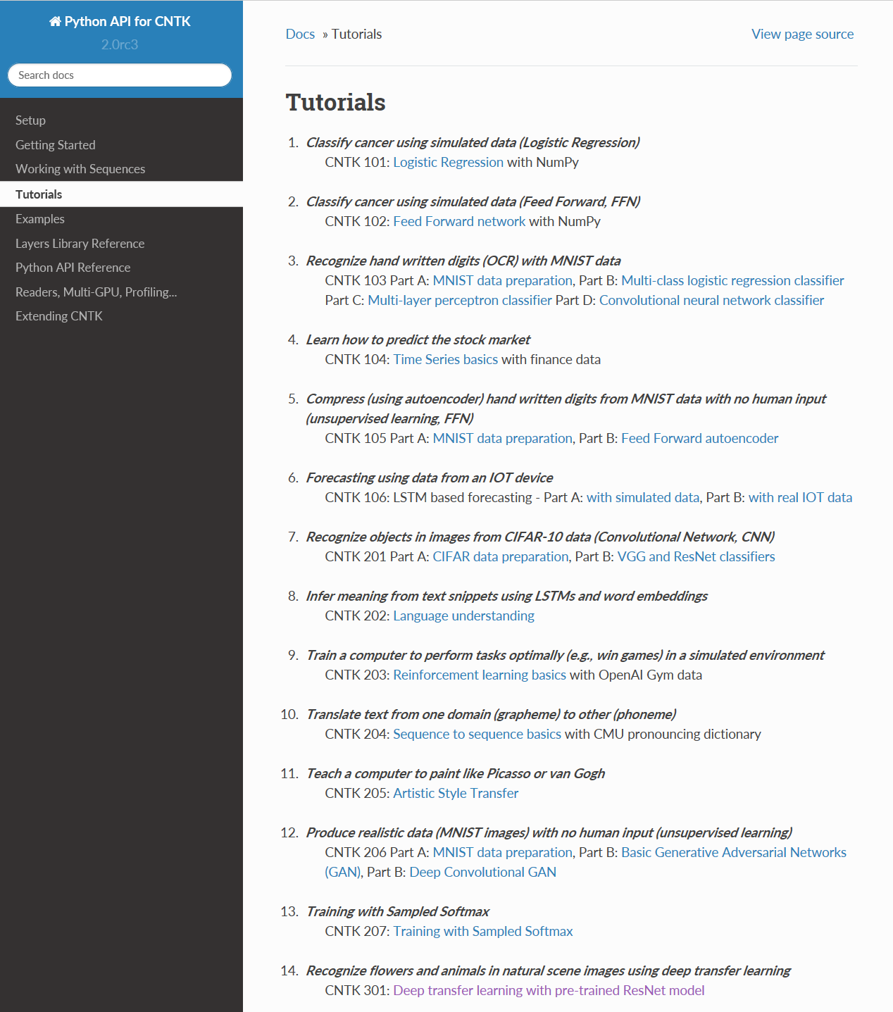
Where to begin?
Tutorials:
https://www.cntk.ai/pythondocs/tutorials.html

Slide 16
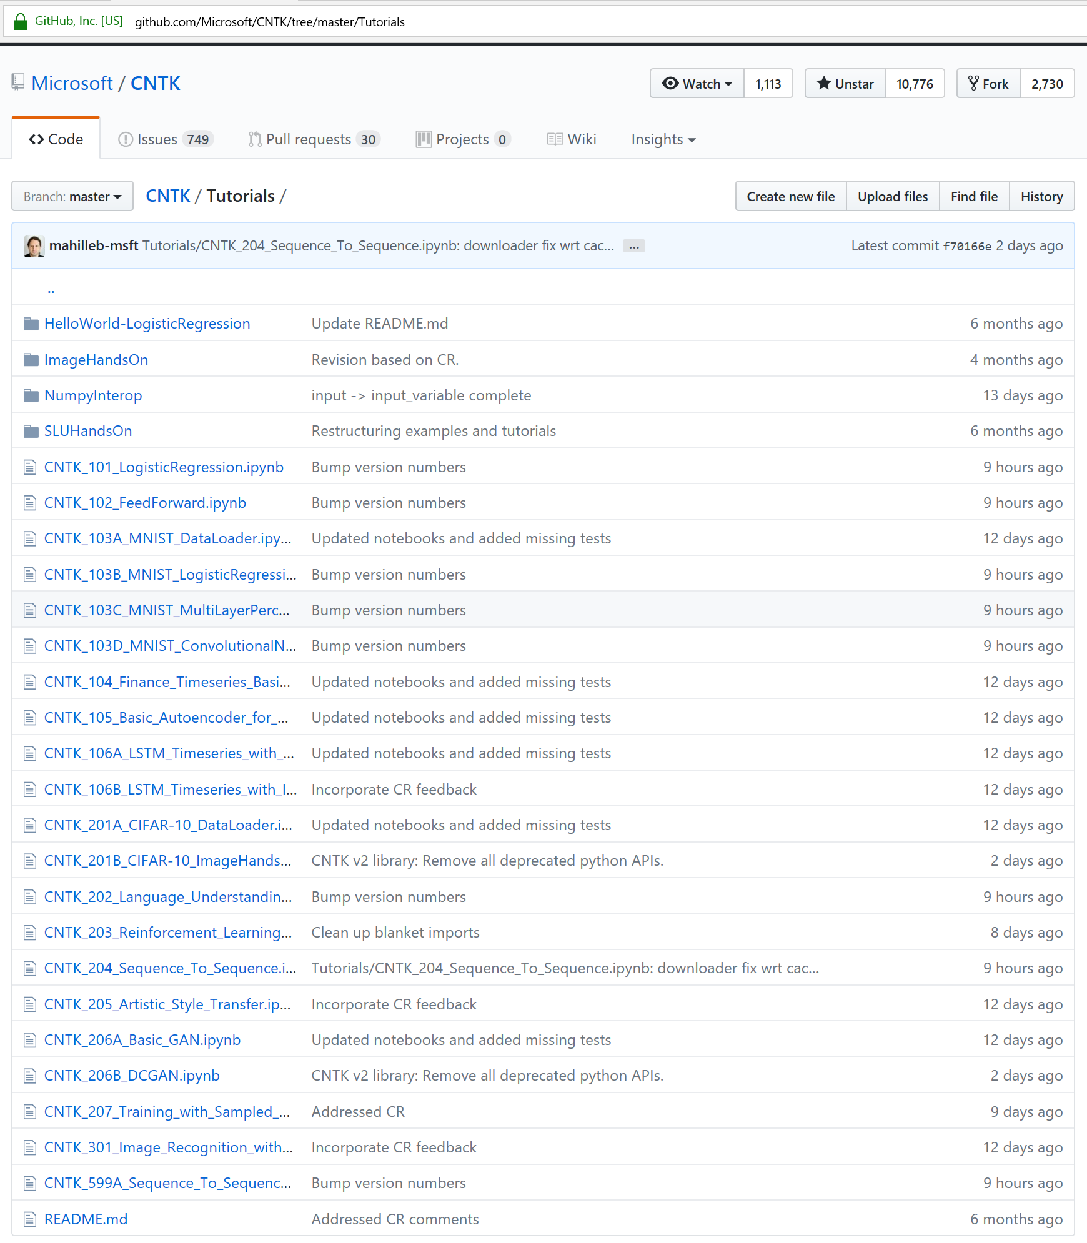
Where to begin?
Tutorials:
https://github.com/Microsoft/CNTK/tree/master/Tutorials

Slide 17
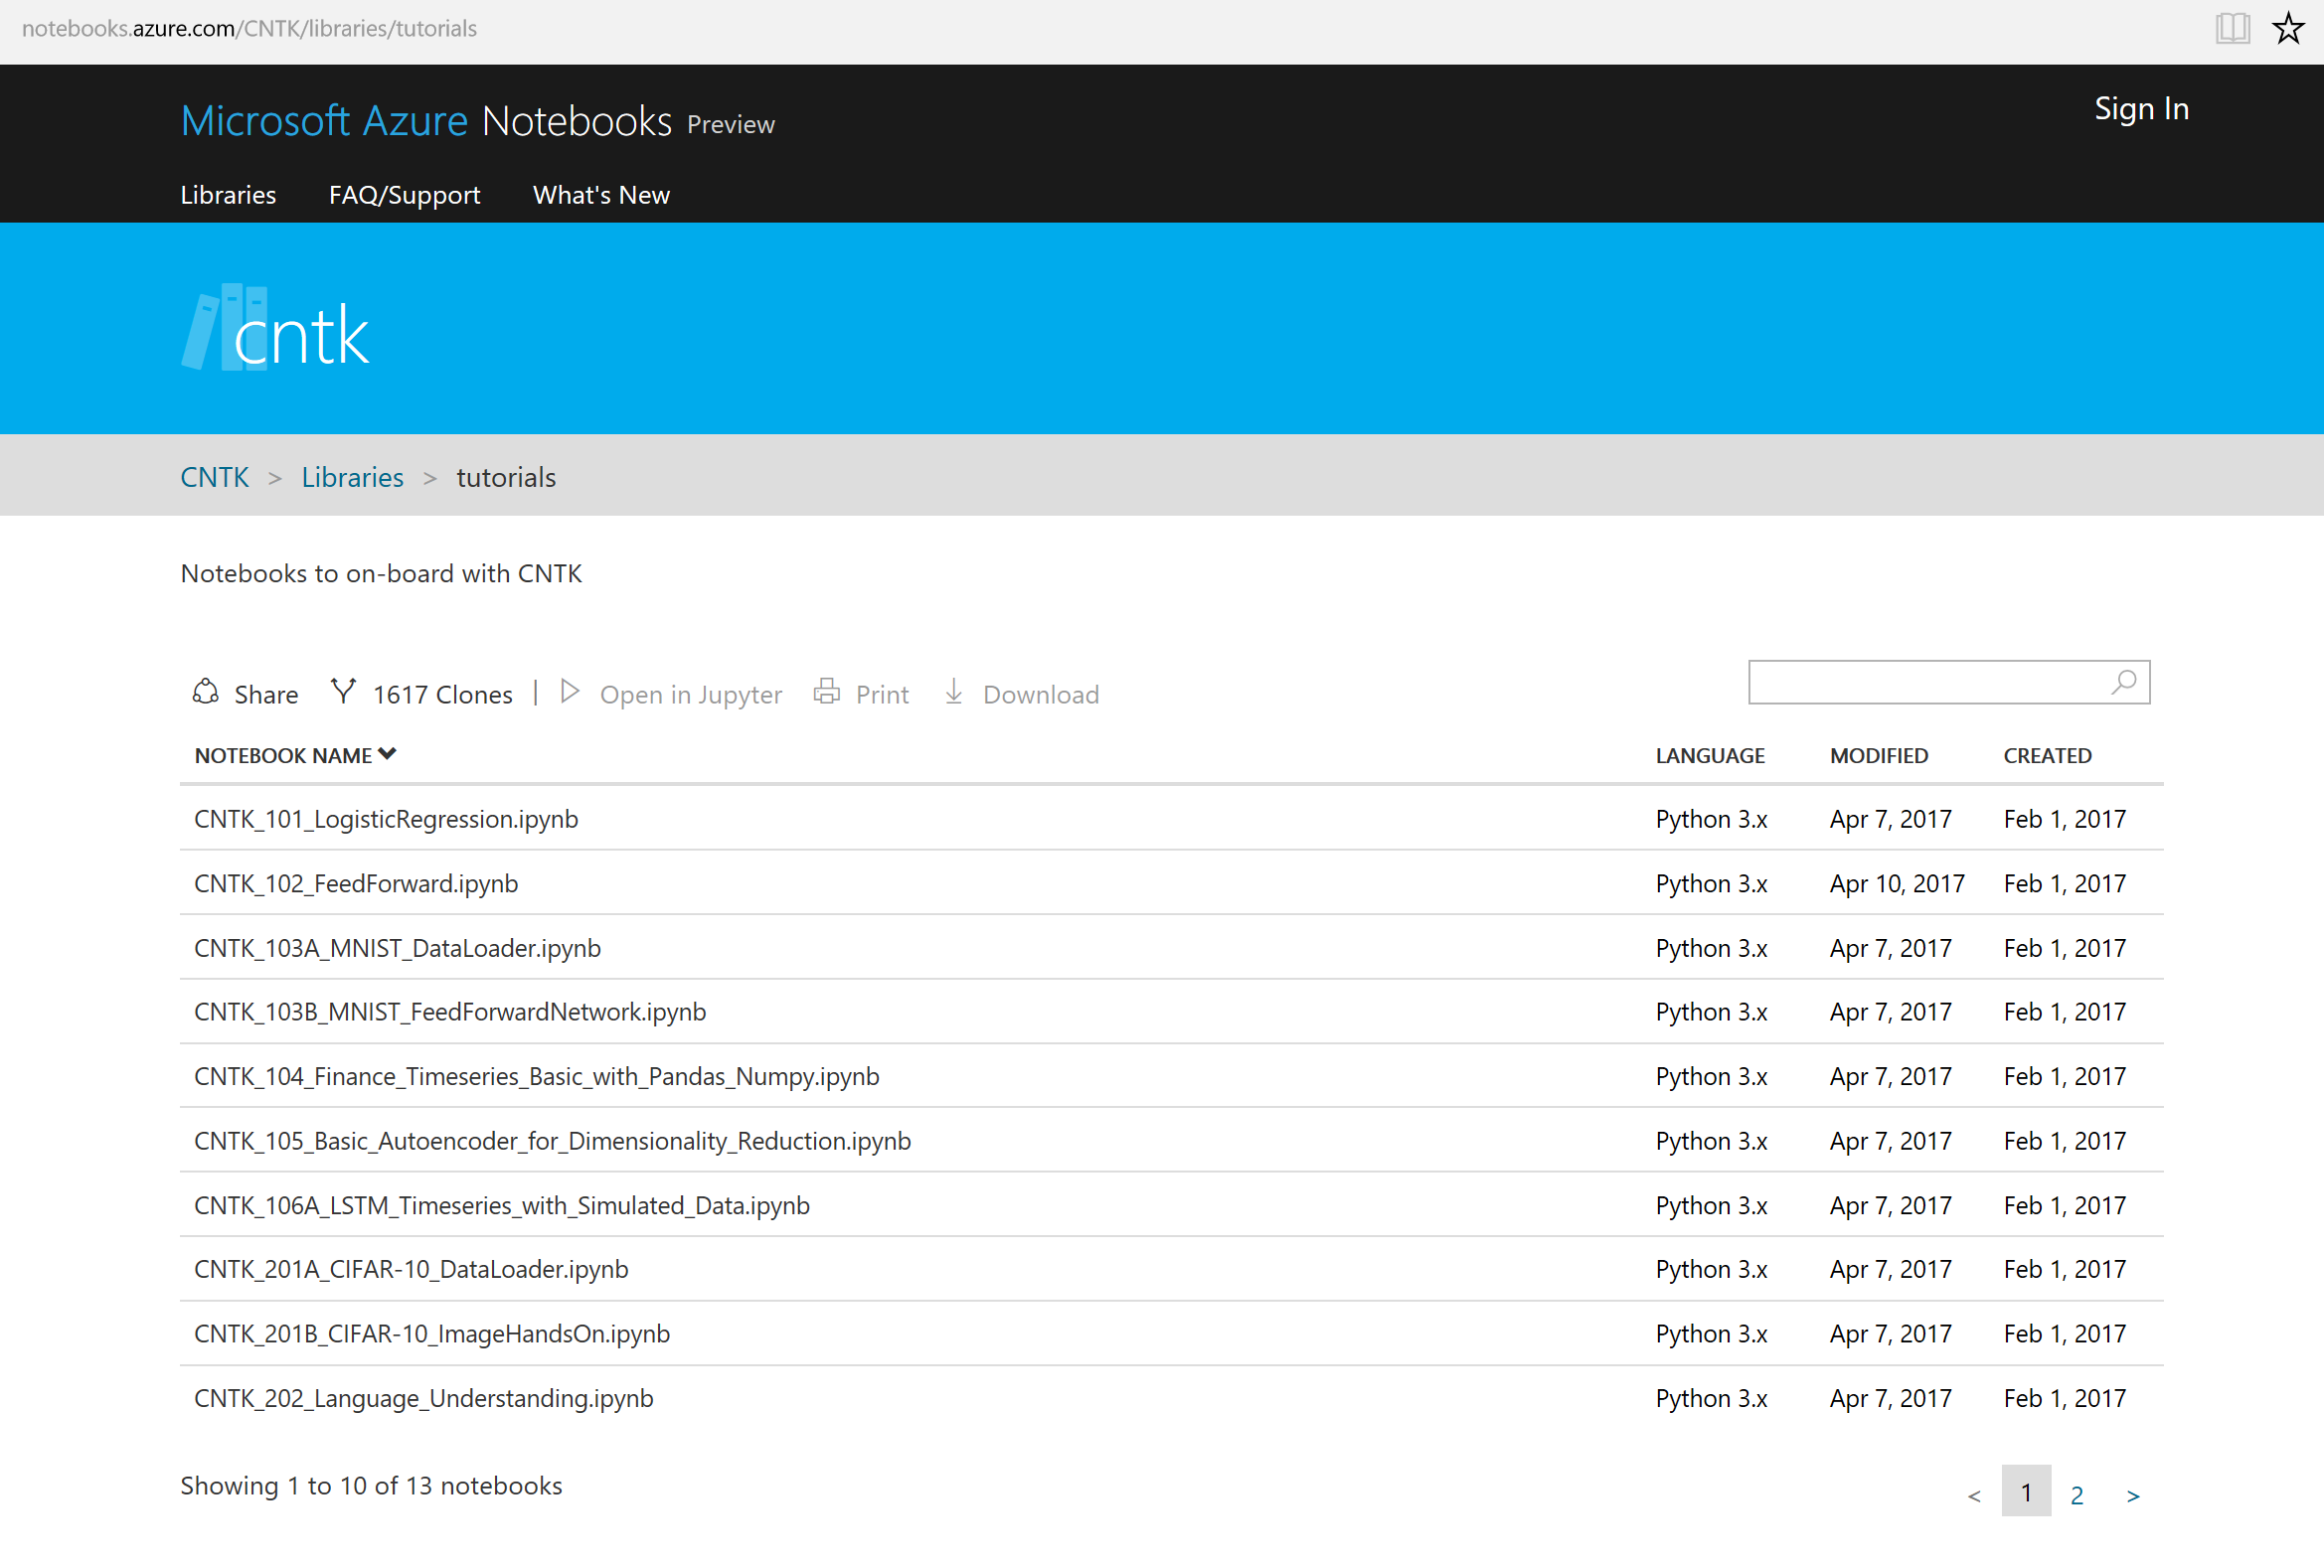
Where to begin?
Azure Notebooks: Try for free pre-hosted
https://notebooks.azure.com/cntk/libraries/tutorials

